Slide 1
Humor Anchors
Ella Kuzmenko

Slide 2
Problem Statement
How do we classify humor?
“My wife tells me I’m a skeptic, but I don’t believe a word she says.”
“A clean desk is a sign of a cluttered desk drawer”
Solution: measure incongruity and ambiguity of the candidate sentences

Slide 3
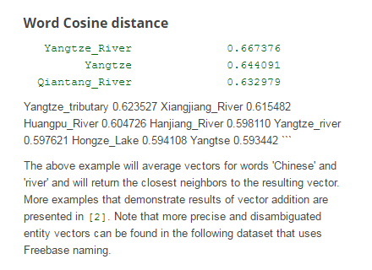
Measure Incongruity
Incongruity: “A clean desk is a sign of a cluttered desk drawer”
What is laughable is often incongruous using either opposition or contradiction
E.g. “clean desk” and “cluttered desk drawer”
METHOD: Word2Vec extracts 2 features and evaluating the meaning distance between content word pairs
METHOD to measure word pairs: skip-gram
Skip-gram:
“Disconnection: the maximum meaning distance”
“Repetition: the minimum meaning distance”

Slide 4
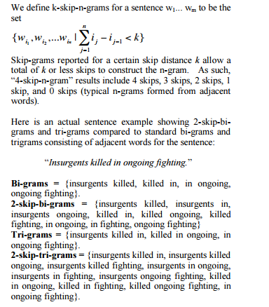
Skip-grams

Slide 5
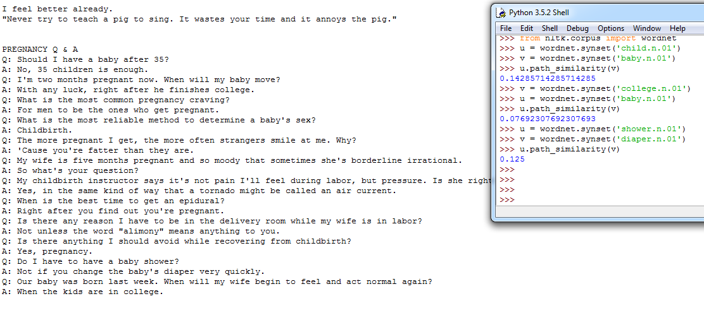
Difficulties

Slide 6
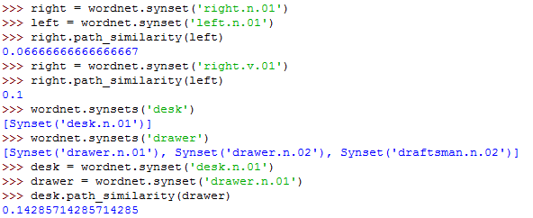
Measure Ambiguity
Ambiguity is changing the listener’s expectation.
E.g. “Did you hear about the guy whose whole left side was cut off? He’s all right now.”
METHOD: WordNet lexical source in NLTK
Sense combination: 1) POS tag, 2) consider all possible meaning via WordNet 3) calculate sense combination as the log(product(of the total number of senses of all the words))
Sense Farmost: farthest path
Sense Closest: closest path

Slide 7
Conclusion: Humor is all about distance; the farther you run away from me, the funnier I seem.

Slide 8
References
Yang, Diyi, et al. "Humor recognition and humor anchor extraction." Proceedings of the 2015 Conference on Empirical Methods in Natural Language Processing. 2015.
"WordNet Interface." WordNet Interface. N.p., n.d. Web. 12 Dec. 2016. <http://www.nltk.org/howto/wordnet.html>.
"Code." Google Code Archive - Long-term Storage for Google Code Project Hosting. N.p., n.d. Web. 12 Dec. 2016. <https://code.google.com/archive/p/word2vec/>.
Guthrie, David, Ben Allison, and Wei Liu. "A Closer Look at Skip-gram Modelling." (n.d.): 63-78. A Closer Look at Skip-gram Modelling. Web. <http://homepages.inf.ed.ac.uk/ballison/pdf/lrec_skipgrams.pdf>.

